Slide 1
Signs and Strategies for Life
Suicide Prevention

Slide 2
You Are Not Alone

Slide 3
Primary Sources
American Foundation for Suicide Prevention https://afsp.org/
Suicide Prevention Resource Center http://www.sprc.org/

Slide 4
Risk Factors
Family history of suicide
Family history of child mistreatment
Anxiety or Depression
History of alcohol and substance abuse
Feelings of hopelessness
Impulsive or aggressive tendencies

Slide 5
Risk Factors cont.
Local epidemics of suicide
Isolation, a feeling of being cut off from other people
Barriers to accessing mental health treatment
Loss (relational, social, work, or financial)
Physical illness
Easy access to lethal methods
Uncomfortable seeking help

Slide 6
Warning Signs
Talking about wanting to die or to kill themselves
Looking for a way to kill themselves, like searching online or buying a gun
Talking about feeling hopeless or having no reason to live
Talking about feeling trapped or in unbearable pain
Talking about being a burden to others

Slide 7
Warning Signs Cont.
Increasing the use of alcohol or drugs
Acting anxious or agitated; behaving recklessly
Sleeping too little or too much
Withdrawing or isolating themselves
Showing rage or talking about seeking revenge
Extreme mood swings

Slide 8
Talk About It… in private
“I’ve noticed that you haven’t been yourself lately, is everything ok with you?”
“I’m worried about you. I’m wondering if we can talk about what’s troubling you?”
“You’ve seemed really (down/sad/angry/unhappy) lately. I’m worried that you might be thinking of hurting yourself or suicide. Can we talk about this?”

Slide 9
What you can do…
CARE - Indicate that you understand
LISTEN - Listen carefully, Maintain eye contact and open body language
RESPECT - Show respect
CHOOSE - They can choose to live
HOPE - Offer realistic hope
HELP - Get professional help

Slide 10
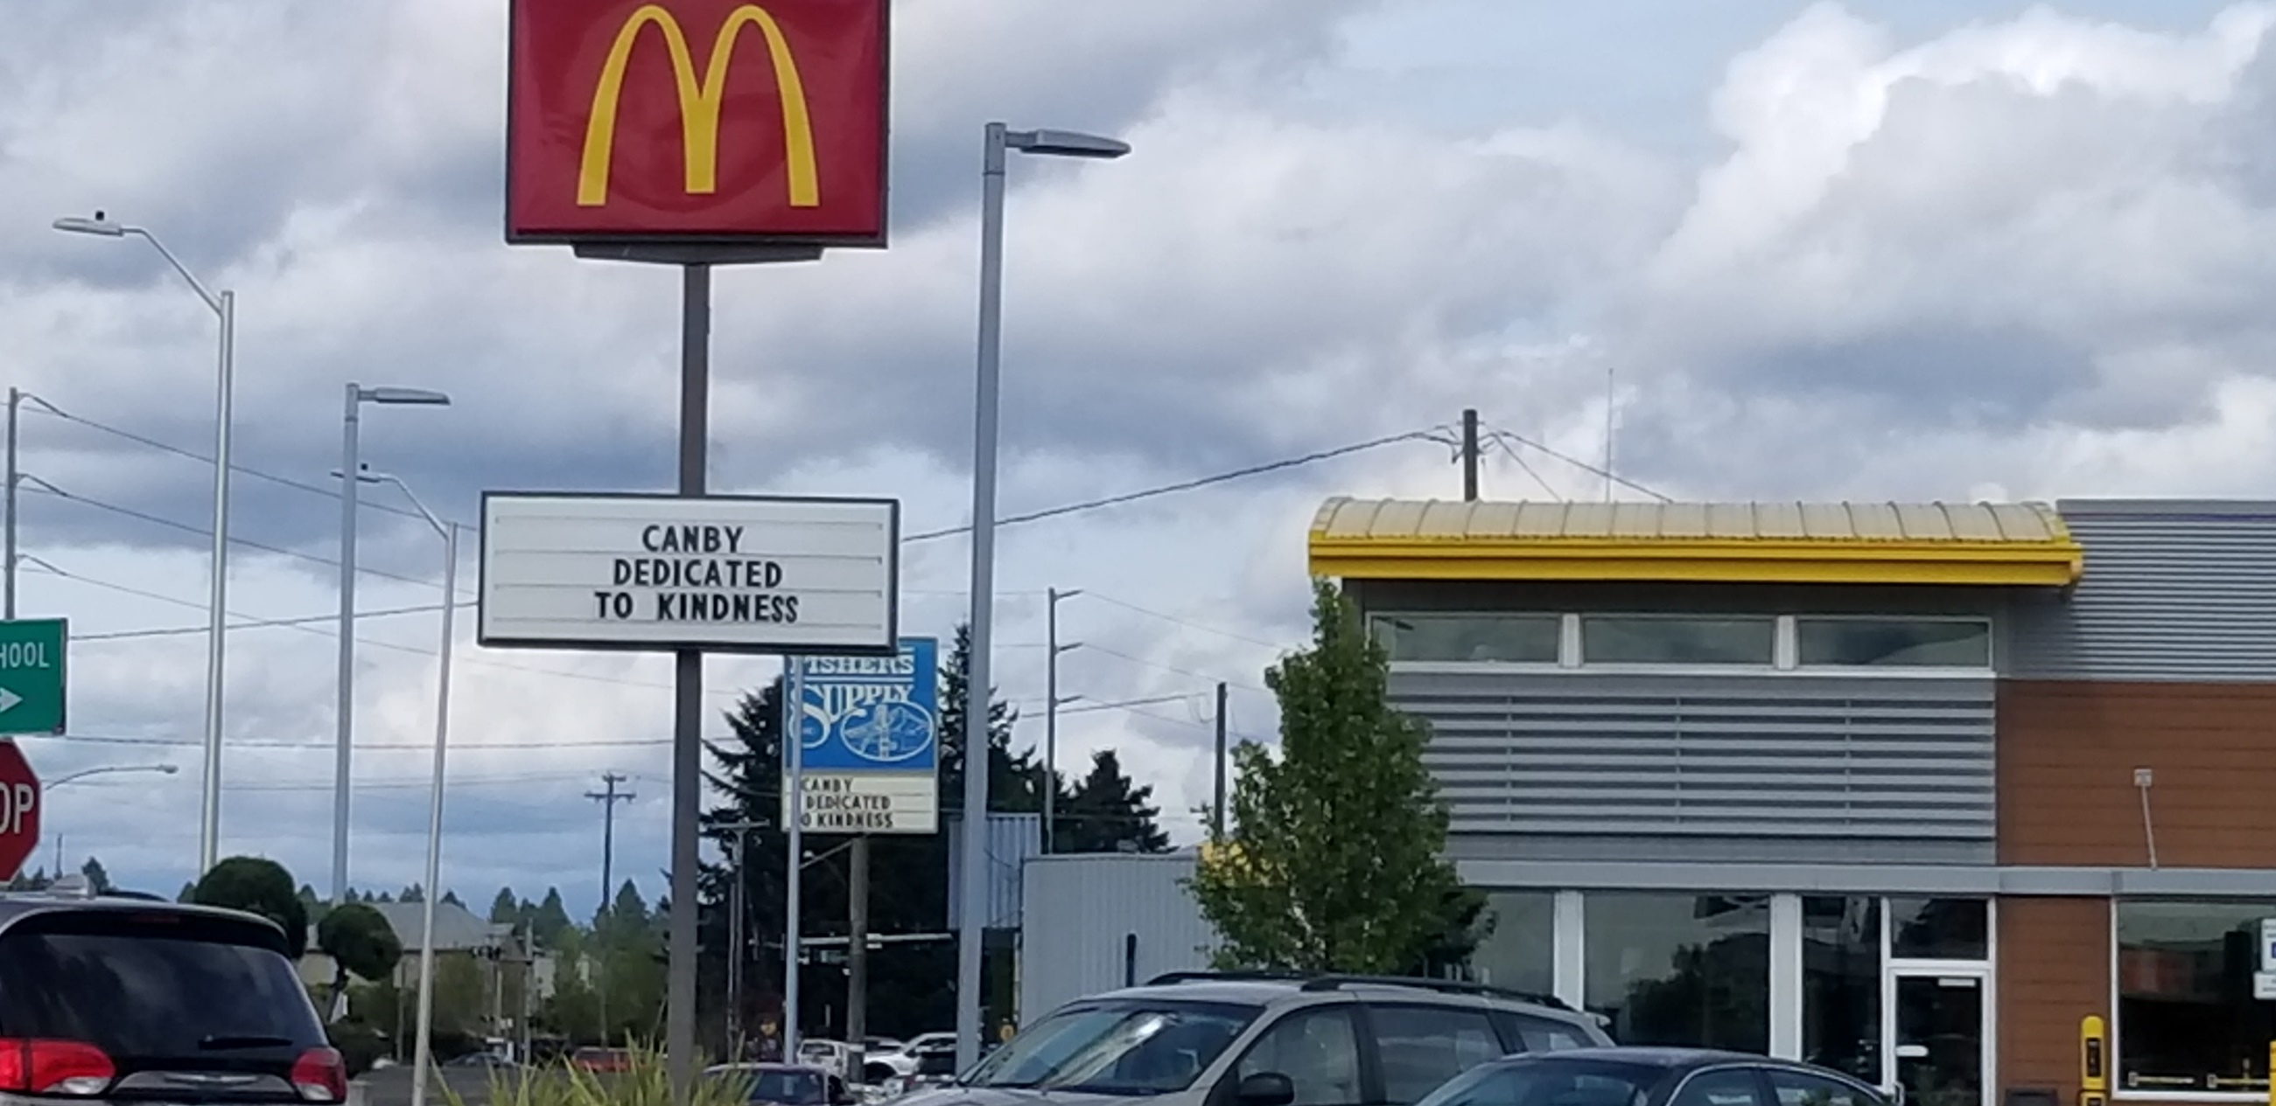

Slide 11
National Suicide Prevention Hotline 1-800-273 8255 Clackamas County Hotline 503-655 8255
https://www.thecanbycenter.org/suicide-prevention-taskforce

Slide 12
No Estas Solo

